Slide 1


Abdul Basit Ahmad
25-05-2024

Slide 2

Outline
Executive Summary
Introduction
Methodology
Results
Conclusion
Appendix

Slide 3
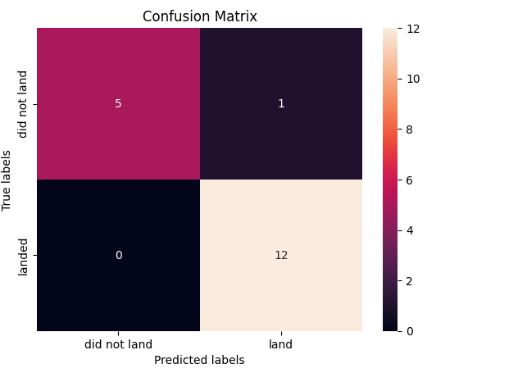
Executive Summary
SpaceX Launch data is downloaded using wget and extracted using beautifulsoup into csv format.
The data is loaded into a dataframe.
EDA is performed to analyze the important features of the data.
Using folium the data is plotted on a map to understand its spatial features.
A dashboard summarizing launch data is prepared.
Finally machine learning techniques are used to predict successful landings.

Slide 4
Introduction
In this era of Commercial Space Age, SpaceX is the most successful space company.
Part of their success is attributable to their utilization of reusable first stage, allowing it to launch a rocket for $62 million compared to $165 million for other competitors.
The goal is to train a machine learning model on publicly available data to predict if a launch will be successful and the price of the launch.
Using data from Wikipedia, the important parameters of a launch are obtained and analyzed using the Data Science packages of Python. This way an estimate for price of launch based on the parameters is obtained.

Slide 5

Section 1

Slide 6
Methodology
Executive Summary
Data collection methodology:
Data was collected from the publicly available data from Wikipedia
Perform data wrangling
The data collected from Wikipedia was in the form of HTML and it was converted to CSV.
Perform exploratory data analysis (EDA) using visualization and SQL
Perform interactive visual analytics using Folium and Plotly Dash
Perform predictive analysis using classification models
The failure and success of a launch is one-hot encoded as the Column ‘Class’ in a dataframe.
The whole dataset is split into a train and test set after scaling and standardization
The data is fit to various methods viz Decision Trees, SVM, Logistic Regression, kNN etc and the most accurate model is determined to be the kNN method and used to predict the price.

Slide 7
Data Collection
The data set was collected from Wikipedia.
Data is downloaded from Wikipedia using the requests library
The data is parsed using the beautifulsoup library and the data in the tables is extracted.
Using helper functions defined in python, the column names are extracted to a python list.
A dict with keys as column names and values as a list of rows of the table is created
This dict is converted to a dataframe and saved as a CSV for further processing

Slide 8
Data Collection – SpaceX API
Data in JSON format is collected from the SpaceX REST API endpoint using GET
It is converted to a DataFrame using the pd.json_normalize function.
The data is standardized and normalized.
The NaN values in Payload Mass column are replaced by averages.
The data is exported to CSV.
https://github.com/darthcoder/Capstone
Data collected from API endpoint using GET
Converted to a dataframe.
Normalized and NaN values removed

Slide 9
Data Collection - Scraping
Data downloaded in HTML format and saved as a CSV
The table is extracted to a dict with the column names as key and data appended to a list as values.
The dict is saved to a DataFrame and exported to a CSV
Using ‘requests’ data in HTML format is downloaded.
This is saved to a BeautifulSoup object.
The relevant table is extracted with the column names being saved as a key and the values being a list in a dict.
The dict is saved to a DataFrame and exported to a CSV.
https://github.com/darthcoder/Capstone/blob/master/week1/jupyter-labs-webscraping.ipynb

Slide 10
Data Wrangling
The dataset was loaded, NaN values and column dtypes identified.
Launches from each site counted as was value counts of each type of orbit.
The outcomes were classified to a class variable.
A new one-hot encoded column was added representing class of failure or success of launch.
https://github.com/darthcoder/Capstone/blob/master/week1/labs-jupyter-spacex-Data%20wrangling.ipynb
Dataset was loaded and NaN values and dtypes identified.
Counts of Launches and orbits were obtained.
A new one hot encoded column representing success or failure of mission was added.

Slide 11
EDA with Data Visualization
A categorical plot of flight number vs payload mass colored by Class.
A categorical plot of flight number vs launch site colored by Class.
A scatter plot of payload vs launch site colored by Class.
A bar plot of success rate vs launch site to visualize which sites are more successful at launch.
A scatter plot of flight number vs Orbit type to understand the evolution of SpaceX’s space launch strategies.
A plot of payload vs orbit type to understand how much payload is sent to which orbit.
Yearly trend of launch success by a line plot.
https://github.com/darthcoder/Capstone/blob/master/week2/jupyter-labs-eda-dataviz.ipynb

Slide 12
EDA with SQL
Distinct launch sites were identified.
5 records where launch sites begin with the string 'CCA'.
total payload mass carried by boosters launched by NASA (CRS)
average payload mass carried by booster version F9 v1.1
the date when the first successful landing outcome in ground pad was achieved was found to be 2015-12-22
the names of the boosters which have success in drone ship and have payload mass greater than 4000 but less than 6000
total number of successful and failure mission outcomes
the names of the booster_versions which have carried the maximum payload mass.
https://github.com/darthcoder/Capstone/blob/master/week2/jupyter-labs-eda-sql-coursera_sqllite.ipynb

Slide 13
Build an Interactive Map with Folium
All launch sites are marked on a map using Icons and grouped into Circles.
All launches are indicated with a marker with the color of marker indicating whether the launch was successful or not.
Red color was used to denote failure and green for success.
This way one can get a quick overview of whether or not a given launch was successful and where it was on the map.
Interesting points of interest were marked on the map near the launch sites.
https://github.com/darthcoder/Capstone/blob/master/week3/lab_jupyter_launch_site_location.ipynb

Slide 14
Build a Dashboard with Plotly Dash
A dropdown for selecting the launch site, a slider for selecting the payload mass were made.
On selecting a launch site, a pie chart showing the percentage of successful and failed launches from that site are displayed. There is the option of displaying an aggregated pie chart of all the sites.
A range slider was made to select the payload mass.
A scatter plot of payload mass vs success was displayed, colored by the booster type to easily spot trends in payload mass and success and its dependence on the type of booster used.
https://github.com/darthcoder/Capstone/blob/master/week3/spacex_dash_app.py

Slide 15
Predictive Analysis (Classification)
The data is scaled and transformed using the fit and transform methods of the StandardScaler class.
The ‘Class’ one hot encoded column that stored the success or failure of a launch is converted to a Numpy array named Y to allow it to be
Add the GitHub URL of your completed predictive analysis lab, as an external reference and peer-review purpose

Slide 16
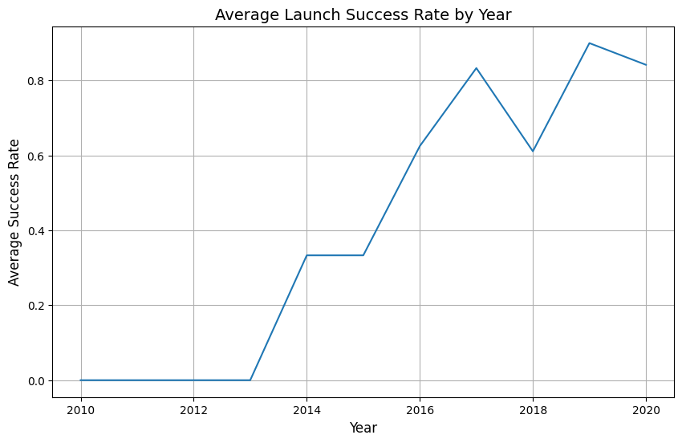
Results

Slide 17
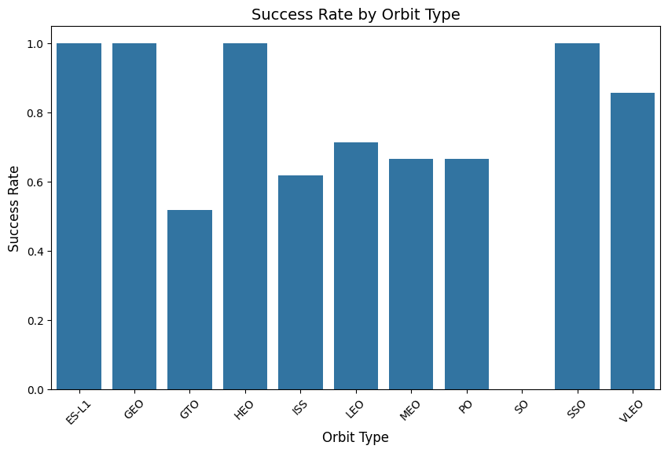
Results

Slide 18
Results

Slide 19

Section 2

Slide 20
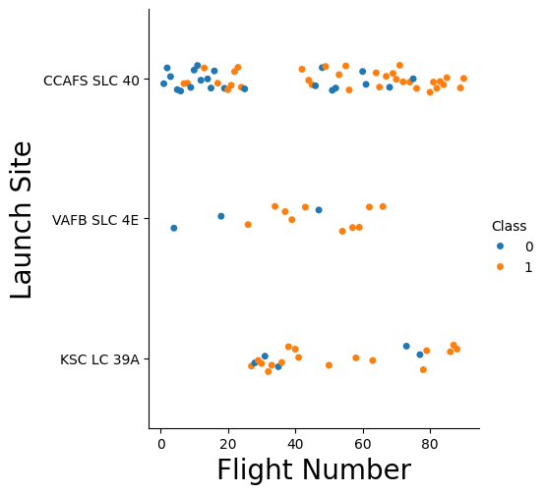
Flight Number vs. Launch Site

Slide 21
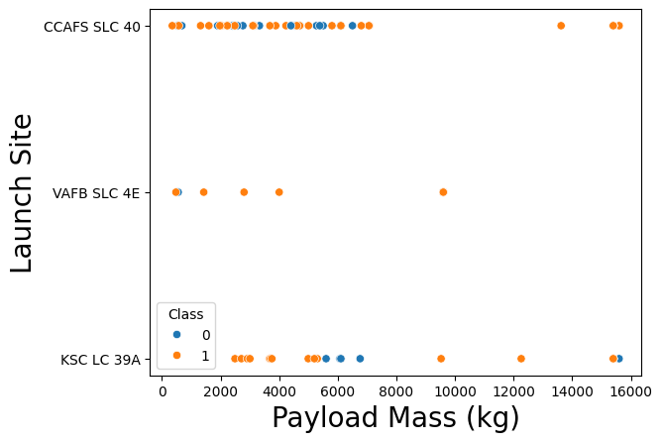
Payload vs. Launch Site

Slide 22
Success Rate vs. Orbit Type

Slide 23
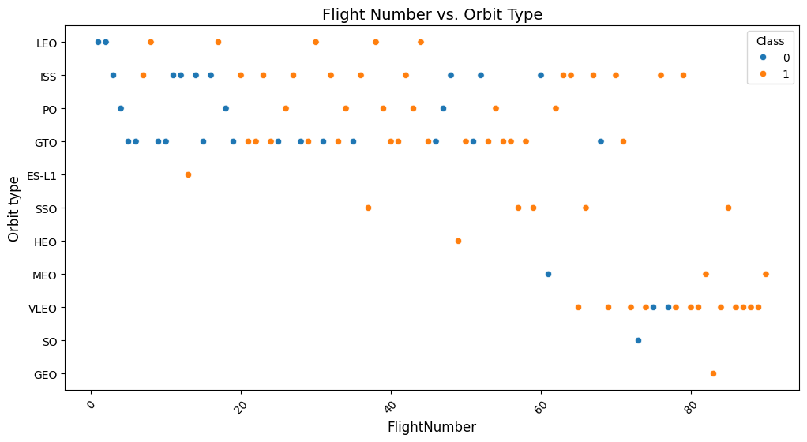
Flight Number vs. Orbit Type

Slide 24
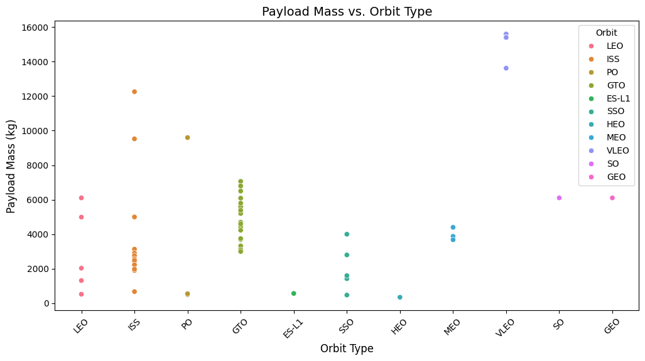
Payload vs. Orbit Type

Slide 25
Launch Success Yearly Trend

Slide 26
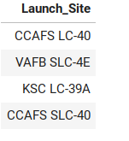
All Launch Site Names
The distinct clause is used to select the distinct launch sites.
The distinct launch sites are as follows:

Slide 27
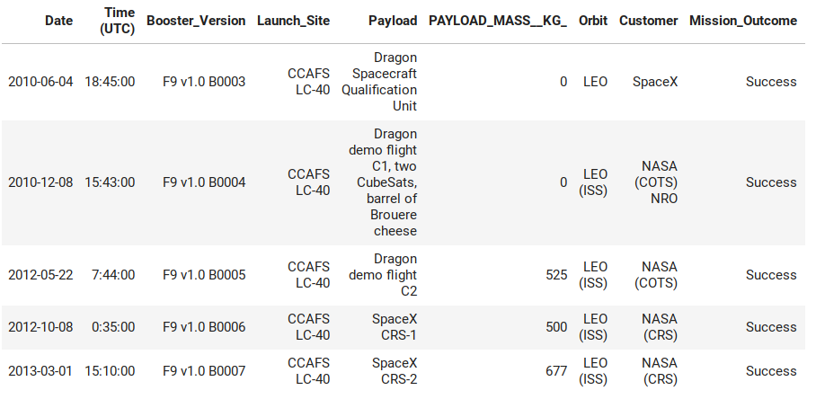
Launch Site Names Begin with 'CCA'
5 records where launch sites begin with `CCA`
The results are as follows

Slide 28
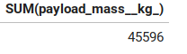
Total Payload Mass
The total payload carried by boosters from NASA
The query is shown below

Slide 29
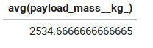
Average Payload Mass by F9 v1.1
Average payload mass carried by booster version F9 v1.1
Query is as follows

Slide 30
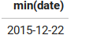
First Successful Ground Landing Date
First successful landing outcome on ground pad
Query is as follows

Slide 31
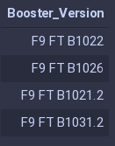
Successful Drone Ship Landing with Payload between 4000 and 6000
List of the names of boosters which have successfully landed on drone ship and had payload mass greater than 4000 but less than 6000
The query result with a short explanation is shown here
The booster version column is chosen from the table where the condition is expressed by the joint Boolean condition Landing_outcome is Success (drone ship) and the payload_mass__kg_ column is between 4000 and 6000.

Slide 32
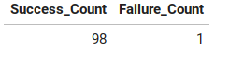
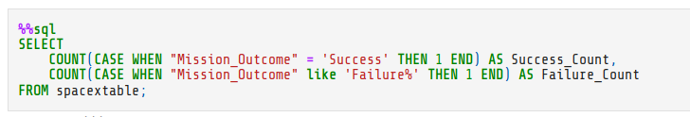
Total Number of Successful and Failure Mission Outcomes
Calculate the total number of successful and failure mission outcomes
The query result with a short explanation here
The cases of Mission outcome are summed using the Count function and displayed.

Slide 33
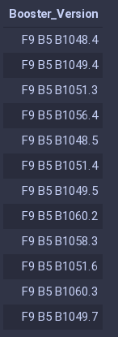
Boosters Carried Maximum Payload
The query is:
List of the names of the booster which have carried the maximum payload mass

Slide 34
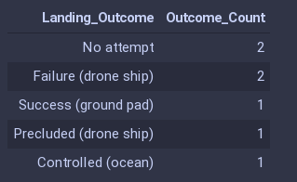
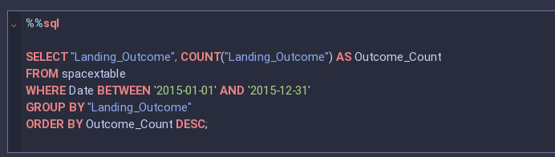
2015 Launch Records
List of the failed landing_outcomes in drone ship, their booster versions, and launch site names for in year 2015
The query is as shown

Slide 35
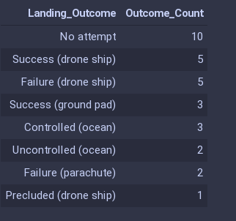
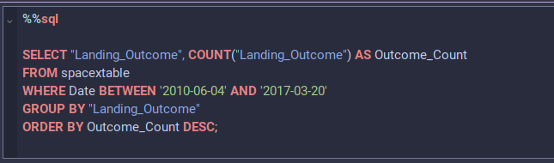
Rank Landing Outcomes Between 2010-06-04 and 2017-03-20
Rank of the count of landing outcomes (such as Failure (drone ship) or Success (ground pad)) between the date 2010-06-04 and 2017-03-20, in descending order
Query

Slide 36

Section 3

Slide 37
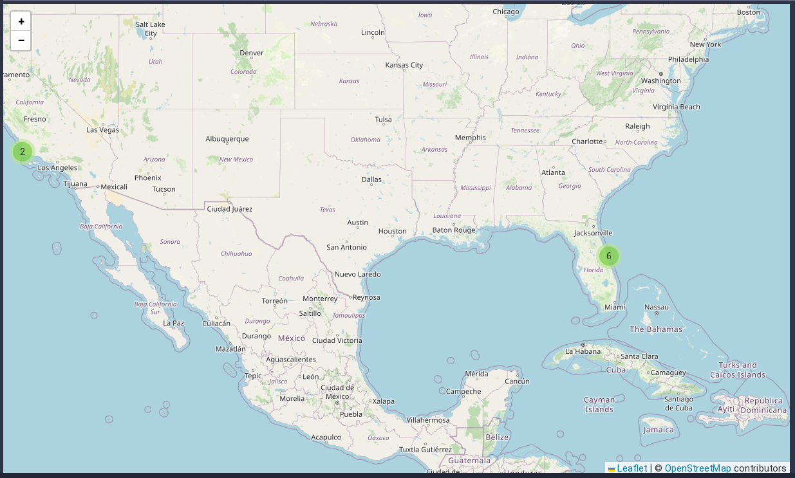
Map of Launch Sites

Slide 38
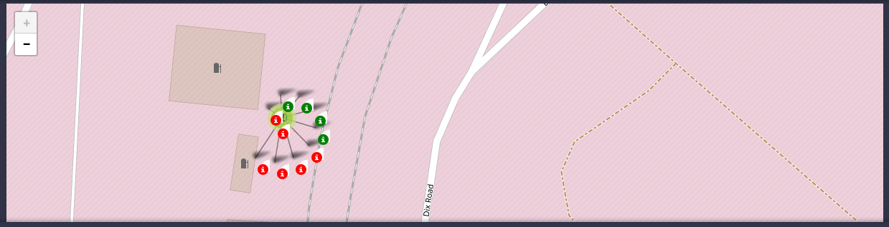
Color Labelled Launch Outcomes

Slide 39
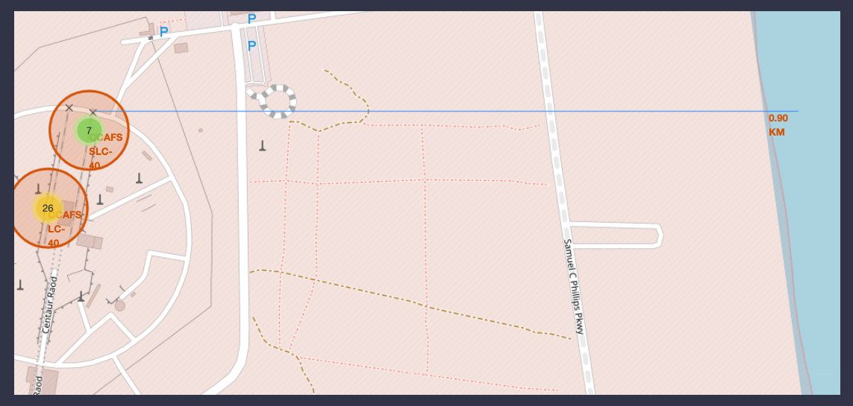
Points of Interest

Slide 40

Section 4

Slide 41
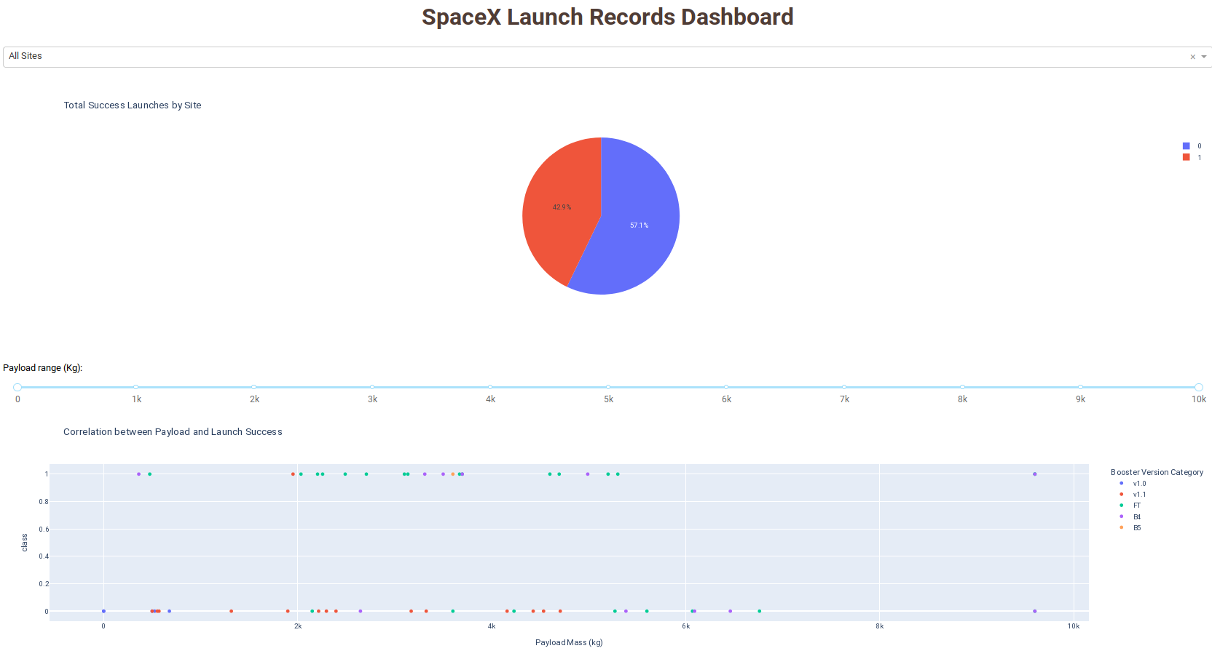
Total Dashboard

Slide 42
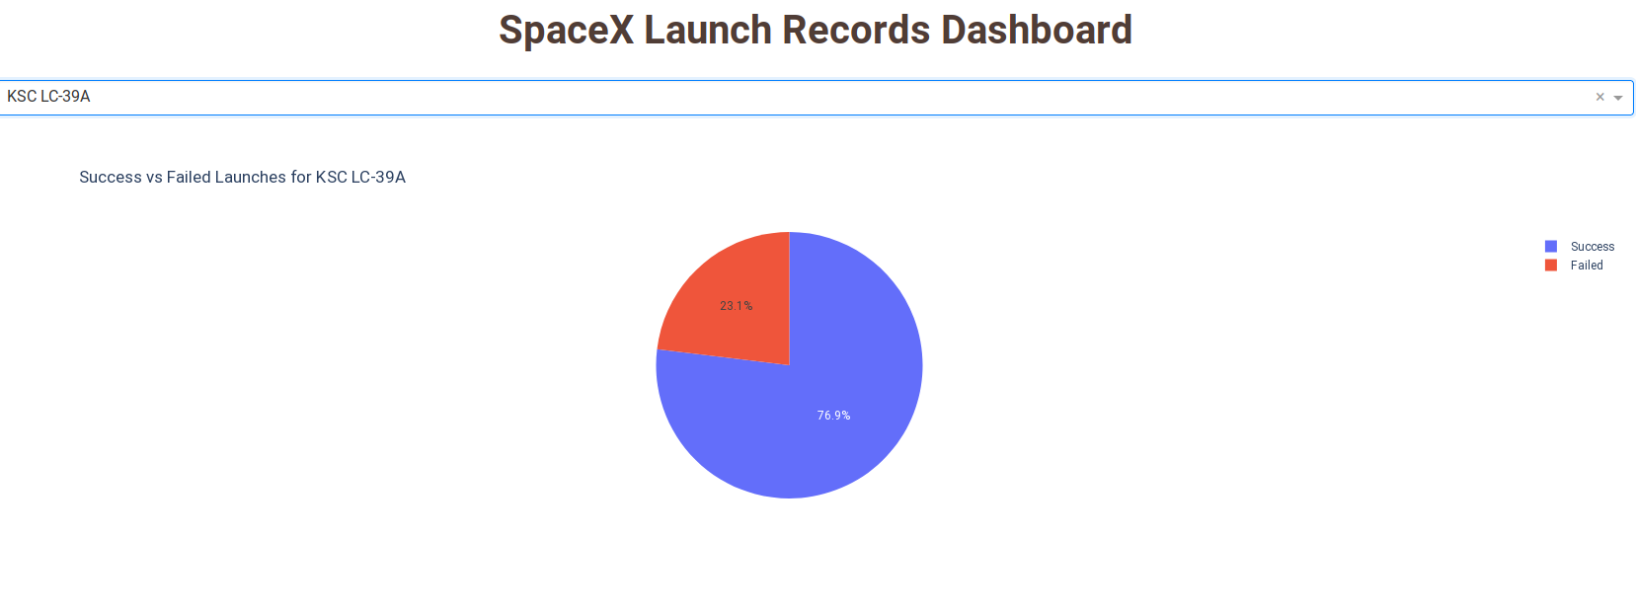
Pie-chart with Highest Success Ratio

Slide 43
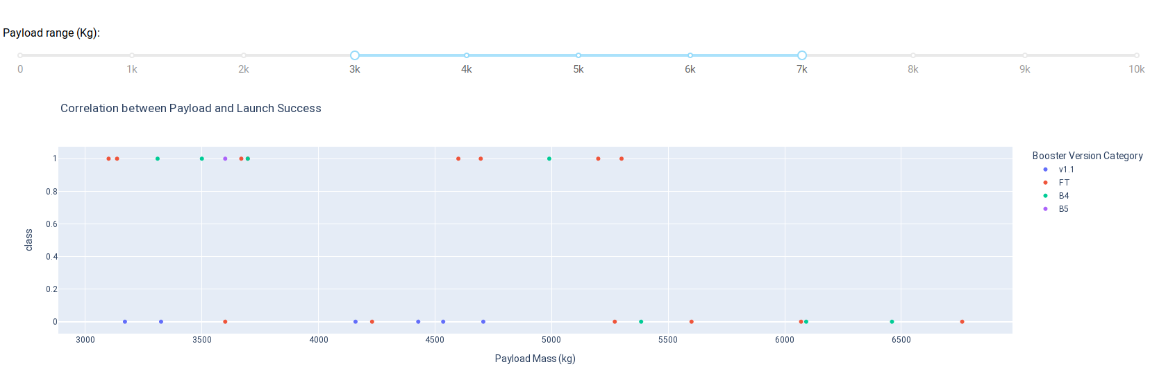
Payload vs. Launch Outcome

Slide 44

Section 5

Slide 45
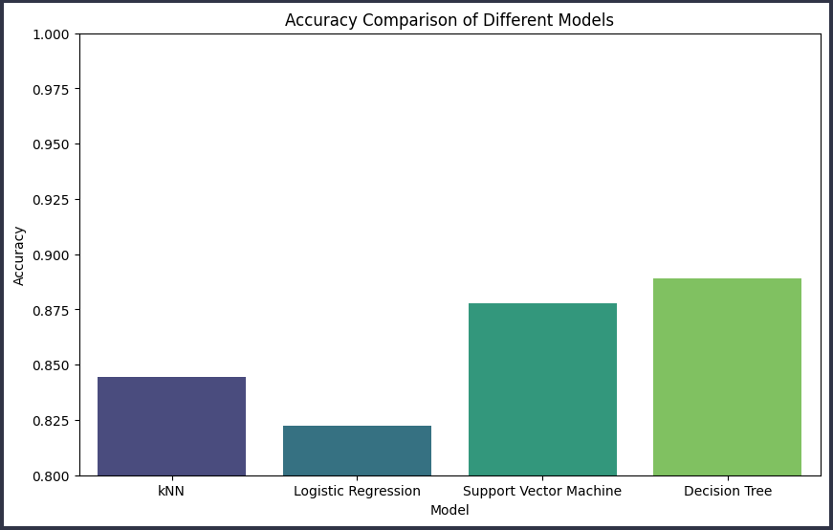
Classification Accuracy
Decision tree has the highest accuracy

Slide 46
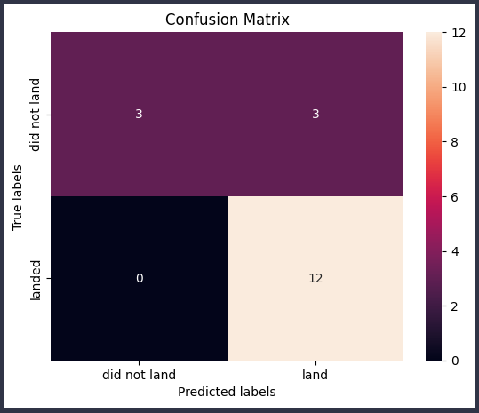
Confusion Matrix
Confusion matrix for Decision tree.

Slide 47
Conclusions
Point 1
Point 2
Point 3
Point 4
…

Slide 48
Appendix
Include any relevant assets like Python code snippets, SQL queries, charts, Notebook outputs, or data sets that you may have created during this project

Slide 49


